Slide 1

Chapter 10
Love and Relationships

Slide 2

What is love?
Psychologists have proposed several different definitions of love and its many varieties.
We will cover four:
  Passionate and Companionate Love
  Love Styles
  The Triangular Theory of Love
  Love 2.0

Slide 3
Passionate and Companionate Love
The simplest recognition of the varieties of love was offered by Berscheid and Hatfield-Walster (1969)
Two broad categories:
  Passionate love: Feelings of extreme absorption. People in passionate love often experience mood swings from ecstasy to anguish, and fear of losing one another.
  Companionate love: A calmer and perhaps deeper state of unshakable affection characterized by mutual self-disclosure, the intertwining of lives, and a sense of warmth or peace.

Slide 4
Passionate Love
The intense arousal that fuels a romantic union
A state of intense longing for union with another
It is a complex functional whole including appraisals or appreciations, subjective feelings, expressions, patterned physiological processes, action tendencies, and instrumental behaviors.
Tend to fall passionately in love with people who are relatively good looking, personable, affectionate and similar to ourselves.
Generally very fleeting

Slide 5
Companionate Love
The soothing, steady warmth that sustains a relationship
Involves feelings of mutual respect, trust and affection, while passionate love involves intense feelings and sexual attraction.
Manifested in a strong bond and intertwining of lives that brings about feelings of comfort and peace

Slide 6
Love Styles
Susan and Clyde Hendrick (1986) propose a more complex taxonomy of love, comprising six love styles:
  Eros: passionate love, intense emotions of desire and sometimes obsessive thoughts.
  Ludus: “Game-playing” or flirtatious love, attraction or affection without commitment.
  Storge: Committed love, warmth and affection.
  Pragma: Practical love, pragmatic reasons to be together.
  Mania: Painful love, sense of jealousy or dependence.
  Agape: Selfless love, orientation toward giving rather than receiving.
Notes:
Grateful people more likely to make positive interpretations of situations and more likely to remember events more positively.

Slide 7
Love Styles
Henrick study on dating couples
Happy couples showed similar love styles
Higher scores on eros—higher relationship satisfaction
Male are more satisfied with the relationship when women are passionate and altruistic
Eros, storage, ludus, pragma, mania, agape.
People who scored high on the eros style tended to be paired with partners who also scored high on it.
Ludus style, in women, significantly decreased satisfaction for their male partners.
Mania style in men decreased satisfaction for their female partners.
Notes:
Grateful people more likely to make positive interpretations of situations and more likely to remember events more positively.

Slide 8
Triangular Theory of Love
Developed by Robert Sternberg (1996).
Places various types of love along three dimensions:
  Intimacy or liking (warmth, closeness)
  Passion (intense emotional response)
  Commitment (decision to maintain relationship)
Different types of love are characterized by different levels of each of these dimensions. For instance, ”romantic love” involves high levels of both intimacy and passion.
Notes:
Grateful people more likely to make positive interpretations of situations and more likely to remember events more positively.

Slide 9
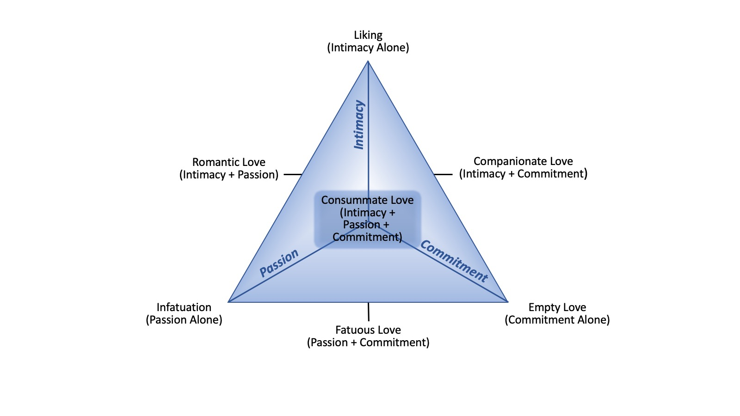
Triangular Theory of Love
Notes:
Grateful people more likely to make positive interpretations of situations and more likely to remember events more positively.

Slide 10
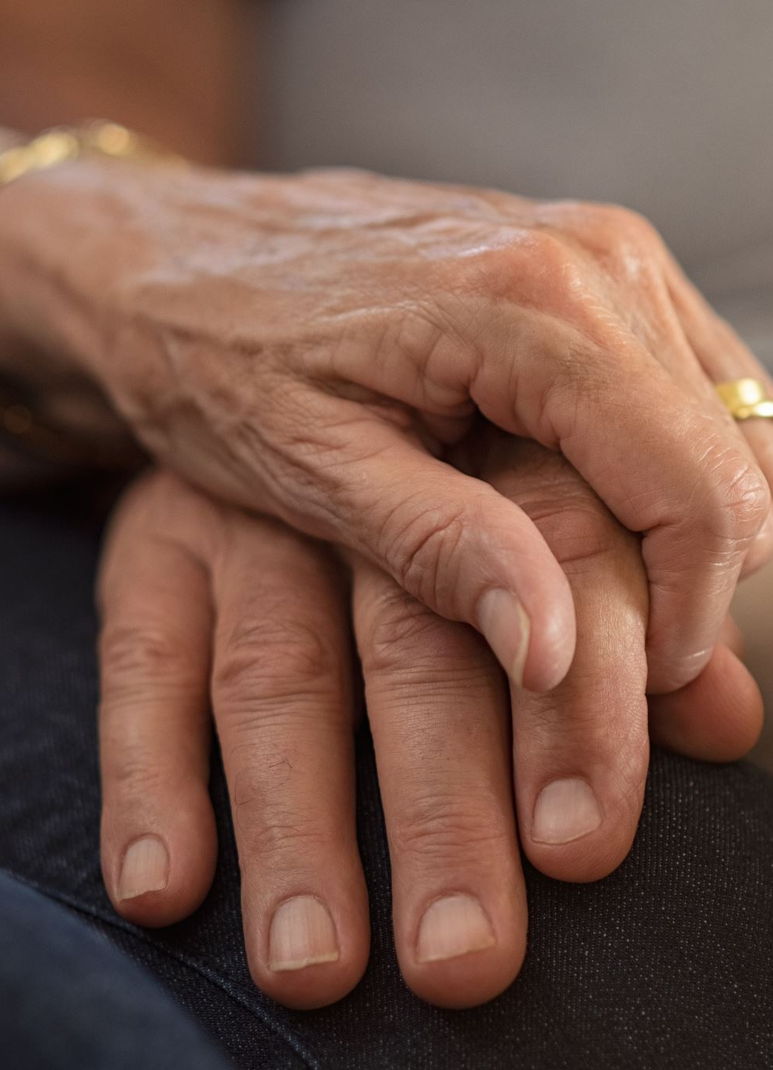
Love 2.0
Developed by Barbara Fredrickson (2013).
Argues that love isn’t passion, commitment, loyalty, trust, family connection, or romance. These can accompany love, but they aren’t love itself.
Love is a moment-to-moment emotional experience characterized by warm and mutual caring, something called “shared positivity.”
A moment of love occurs anytime two people connect over a shared positive emotion, even between strangers.
Notes:
Grateful people more likely to make positive interpretations of situations and more likely to remember events more positively.

Slide 11
Love 2.0
Positivity resonance:
  When we experience shared positivity, our brains and behaviors “sync up,” called positivity resonance. People may mirror each other’s posture or vocal tone, nod along with each another, make eye contact, or smile.
  Important study: Liu et al. (2017)
    Positivity resonance can be reflected in the brain.
    Researchers recorded a native English speaker and two native Turkish speakers telling real-life stories while wearing a brain imaging device known as functional near infrared spectroscopy (fNIRS).
    Later, they played these stories for study participants—all of whom were English speakers—while they also wore fNIRS equipment.
    Results showed that listeners’ brain activity was correlated with the story-teller’s brain activity; but this was only the case when they listened to the English speakers.
Notes:
Grateful people more likely to make positive interpretations of situations and more likely to remember events more positively.

Slide 12
Love 2.0
Two additional biological mechanisms are hypothesized to play a role in love, as Fredrickson defines it:
  Oxytocin: Often called the “tend and befriend” hormone. Higher levels of oxytocin may help people read social cues as well as be more generous and altruistic.
  Vagus nerve: Extends from the brain to various parts of the body, including the heart, lungs, and digestive tract. Lower “vagal tone” (functioning of the vagus nerve) is associated with lower emotional regulation (Beauchaine, 2001; Thayer et al., 2012). This is important because people who are better able to regulate their emotions tend to act more prosocially toward others.
Notes:
Grateful people more likely to make positive interpretations of situations and more likely to remember events more positively.

Slide 13
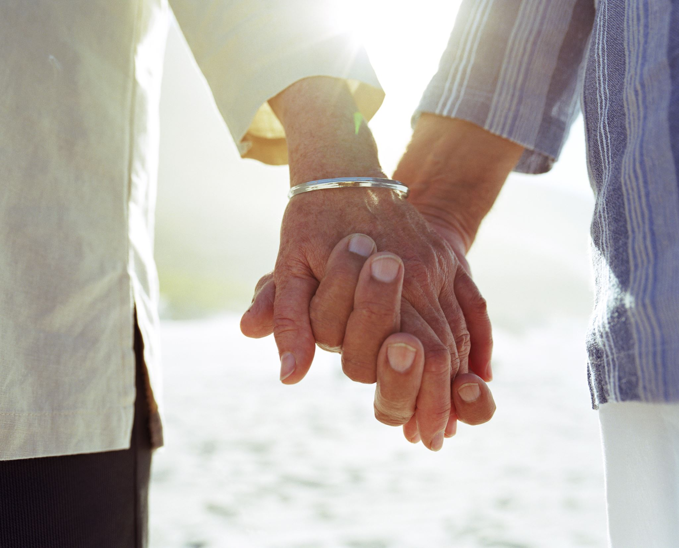
Relationships and Well-Being

Slide 14
Different Kinds of Relationships
Relationships can be conceptualized and measured in various ways, all of which may have somewhat different associations with well-being.
We will cover four kinds of relationships:
Merely having people in one’s life
Friendships
Online/social media relationships
Marriage

Slide 15
Having People in One’s Life
Size of one’s social network (i.e., the number of people in one’s life) is related to greater levels of psychological well-being.
Important Study: Diener & Seligman (2002)
Tracked 222 undergraduates for a semester, administering surveys to participants and people who knew them.
Results: The happiest ten percent of participants spent less time alone than the least happy ten percent. Moreover, they were much more satisfied with their relationships than the unhappy participants, including their close friendships, family relationships, and romantic relationships.

Slide 16
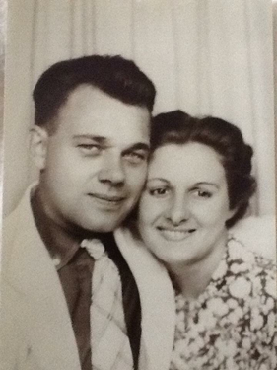
What Attracts Us to Another?
Proximity, physical attractiveness, attitude similarity, reciprocity
Physical allure
The color red
Ideals of attractiveness differ among cultures
Similarity of attitudes and values—see high similarity with happily married couples

Slide 17
Friendships
Friendship: A voluntary interdependence between two people that includes the satisfaction of interpersonal needs or desires such as intimacy, support, or self-validation.
Both quantity and quality of friendships are associated with happiness, but quality matters more.
  Quantity: Although studies have shown positive associations between quantity of friends and psychological well-being (e.g., Berry & Hansen, 1996; Demir & Weitkamp, 2007), correlations are typically below 0.20.
  Quality: Correlations for friendship quality with psychological well-being are generally in the range of 0.20–0.60 (e.g., Brannon et al., 2013; Demir et al., 2015).
  The relationship between friendship quality and well-being appears to depend on the closeness of the friendship. That is, the quality of close friendships—including best friendships—are associated with well-being to a greater degree than the quality of less-close friendships (Demir et al., 2015).

Slide 18
Social Media
In the twenty-first century, the word “friends” can mean people we’ve never met.
Some studies show positive associations between social media use and well-being; others show the opposite. Overall, the research is slightly more weighted toward the negative side (Orben, 2020).
How people use social media matters (Varduyn et al., 2017):
  Passive use (scrolling through posts) is associated with greater social comparison, insecurity, and envy.
  Active use (posting, messaging, etc.) is associated with greater well-being and feelings of social connectedness.

Slide 19
Marriage
Marriage:
  Generally, being married is associated with higher psychological well-being than not being married (Becker et al., 2019; Dush & Amato, 2005; Williams, 2003).
  However, the size of the association is relatively weak (Haring-Hidore et al., 1985).
Divorce:
  About 40 to 50 percent of marriages end in divorce (CDC, 2018).
  The end of a marriage—whether through divorce or death—typically leads to lowered well-being, and this decrease in well-being appears to be stronger than the positive effects of being married (Lucas, 2005).

Slide 20
Marriage
Most research has included only heterosexual couples.
Studies of same-sex couples generally confirm that marriage is associated with greater well-being, with a caveat: It matters if marriage is legally recognized.
Important Study: Wight et al. (2013)
  Years prior to federal recognition of same-sex marriage in the U.S., same-sex marriage was legalized in California for a brief five-month period in 2008. Marriages during this period remained legal, even after same-sex marriage was again prohibited.
  Following this period, researchers accessed data from a statewide survey, which included 1,166 lesbian, gay, or bisexual (LGB) individuals.
  Although the survey didn’t measure well-being, it did measure degree of general psychological distress.
  According to the results, LGB persons in legally recognized marriages were significantly less distressed than both LGB people in registered domestic partnerships (which remained legal in California) and LGB people not in legally recognized relationships.

Slide 21
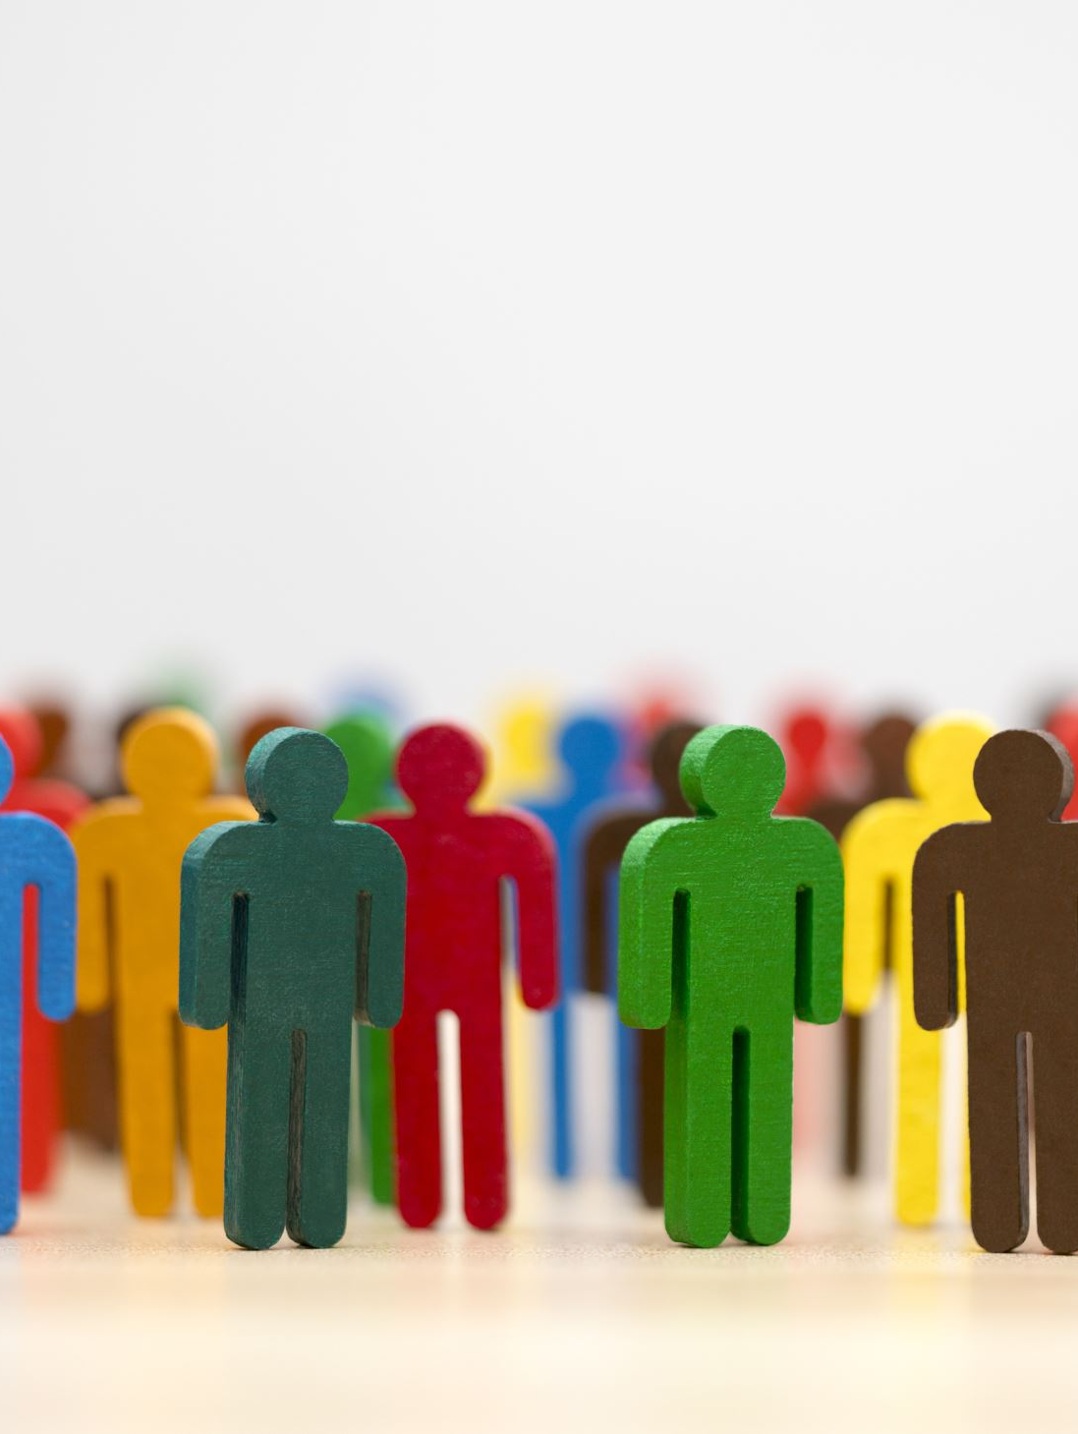
Theoretical Models of Good Relationships

Slide 22
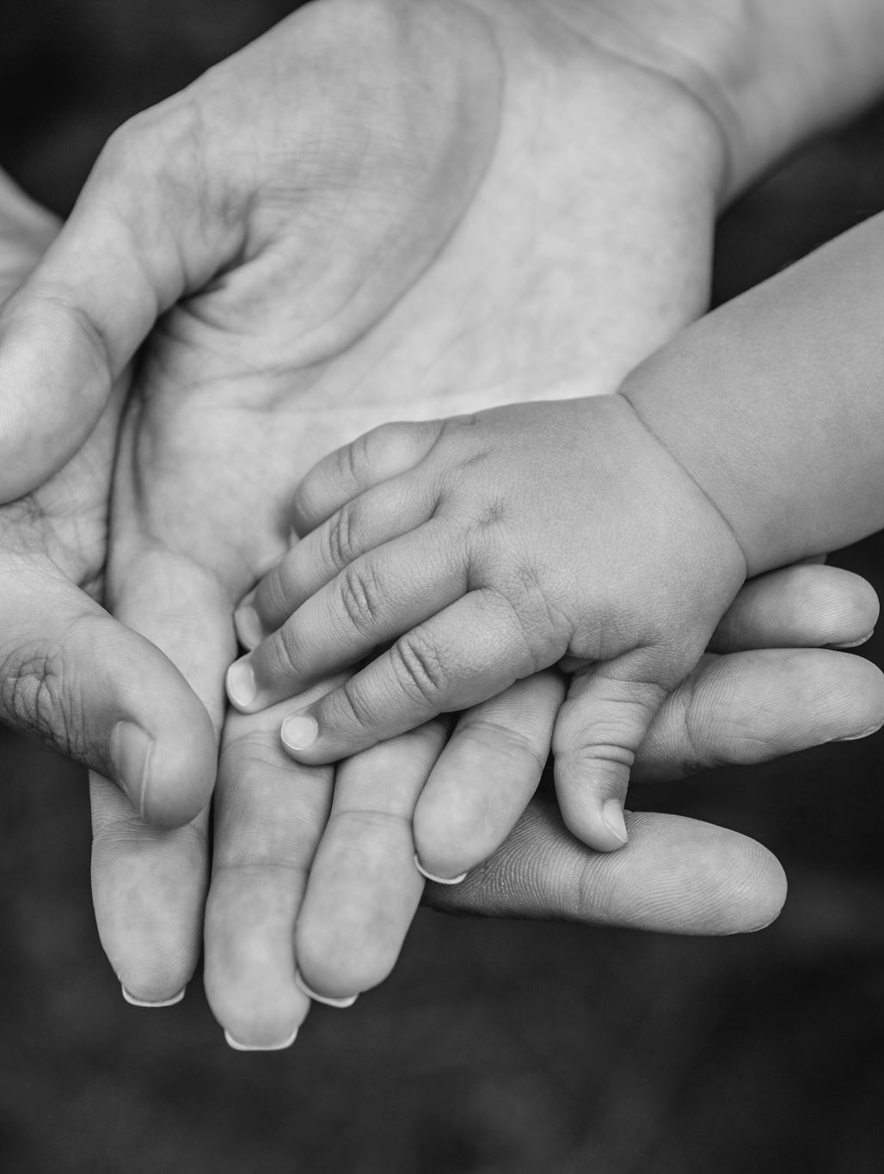
Attachment Theory
Attachment theory was originally developed by John Bowlby (1969) and later expanded by Mary Ainsworth (Ainsworth et al., 1978).
Major assertions of attachment theory:
  Parents and other early caregivers who are dependable and responsive to a child’s needs help that child develop a sense of trust and security, known as a secure attachment style, which children carry into adulthood.
  Adults with a secure attachment style have more stable and satisfying relationships than adults who have insecure attachment styles.
Notes:
Grateful people more likely to make positive interpretations of situations and more likely to remember events more positively.

Slide 23
Attachment Theory
Research supports the second assertion of attachment theory more than the first.
  Adults with a secure attachment style enjoy higher levels of satisfaction and stability in romantic relationships than adults with insecure attachment styles.
  Although studies show that early parent-child relationships predict quality of other relationships in adulthood, the effect isn’t very strong.
Important Study: Dinero et al. (2008)
  Interviewed 269 individuals when they were 15-16 years old together with their parents, then again in their mid-20s together with their romantic partners.
  Used a behavioral coding system to assess various different aspects of the relationships participants had with their parents (as children) and romantic partners (as adults).
  Correlations between the various ways the individuals and their families interacted when they were teenagers and the ways they interacted with their partners a decade later were statistically significant, but only small to moderate, ranging from 0.17 to 0.41.
Notes:
Grateful people more likely to make positive interpretations of situations and more likely to remember events more positively.

Slide 24
Social Exchange Theories
In general, social exchange theories assert that decisions to engage in and remain in relationships, as well as relationship satisfaction, depend on weighing the costs (e.g., companionship, support, sex, material resources) and benefits (e.g., stress, arguments, time compromises).
Two prominent social exchange theories:
Thibault and Kelley (1959)
Rusbult (1980)
Notes:
Grateful people more likely to make positive interpretations of situations and more likely to remember events more positively.

Slide 25
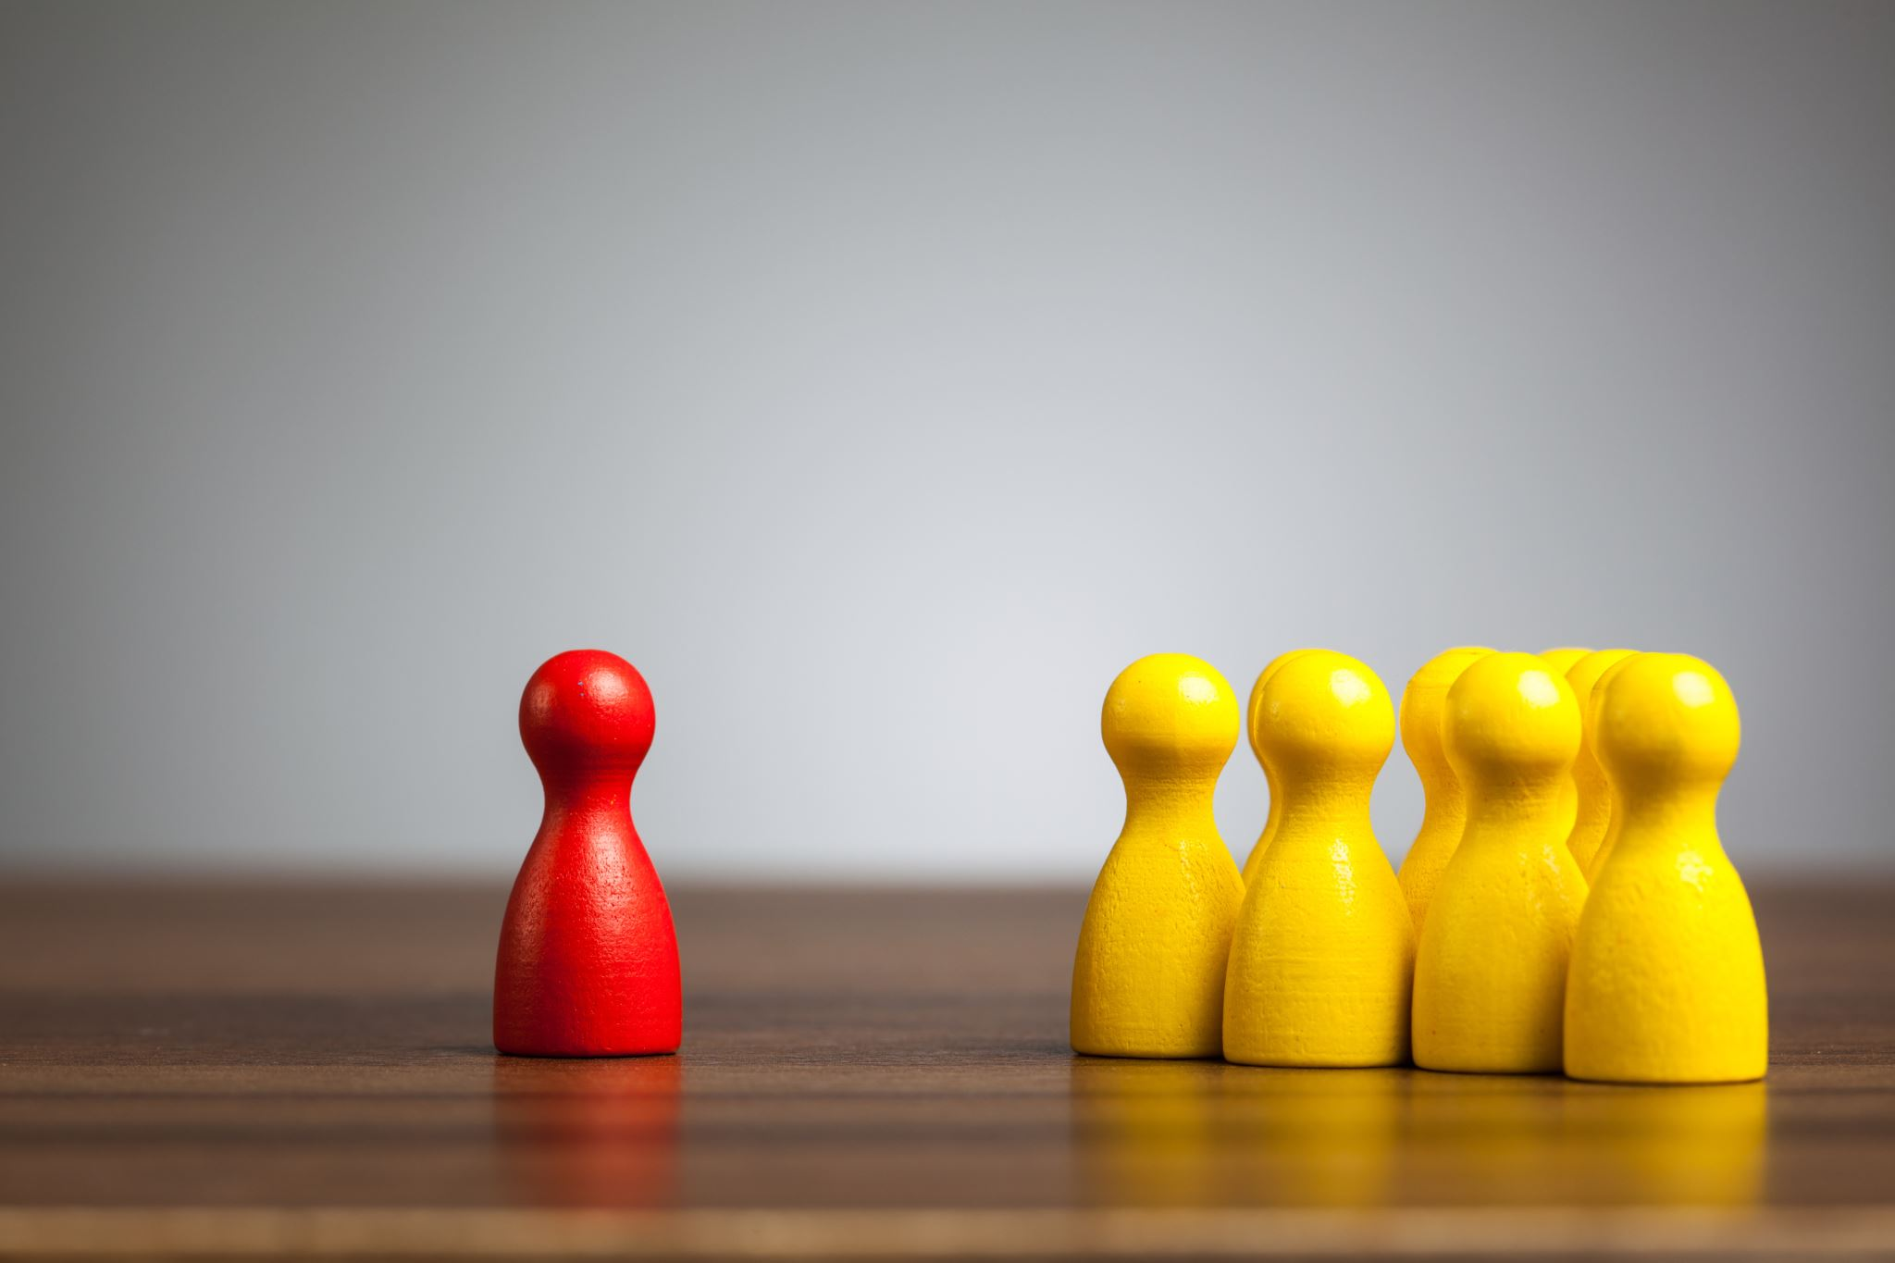
Social Exchange Theories
Thibault and Kelley (1959) proposed that people use two factors when making relationship decisions:
  Comparison level: Evaluation of how attractive the relationship is based on the cost-benefit analysis.
  Comparison level for alternatives: Evaluation of whether other potential relationships would be more rewarding or less costly than the current one.

Slide 26
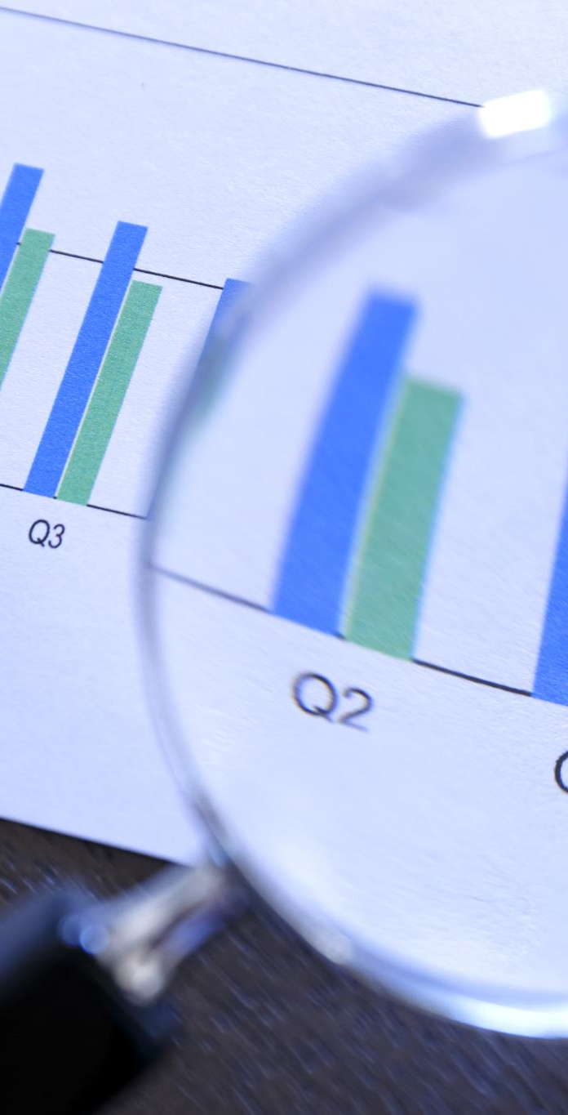
Social Exchange Theories
Rusbult’s (1980) investment theory of commitment asserts that three factors combine to predict relationship commitment:
  Satisfaction level: Similar to “comparison level” in Thibault and Kelley’s theory.
  Quality of alternatives: Similar to “comparison level for alternatives” in Thibault and Kelley’s theory.
  Investment size: Amount of resources put into a relationship (e.g., money, effort, trust, shared memories).
The more someone invests in a relationship, the more likely they are to remain committed, even if the relationship falls short on the other two factors.

Slide 27
Balance Theory of Relationships
Developed principally by John Gottman (1993).
Asserts that the stability and degree of satisfaction in a relationship depend on achieving a balance between negative and positive interactions.
Based on his research, Gottman suggested a 5:1 ratio of positive to negative interactions is necessary for a relationship to be stable.

Slide 28
Balance Theory of Relationships
A couple is regulated if they have a stable balance of positive and negative interactions, and unregulated if not.
Three types of regulated couples:
  Validating couples are calm and have an easy-going.
  Volatile couples experience a wide array of ups and downs emotionally, but tend to eventually work things out.
  Conflict minimizing couples try hard to avoid or ignore disagreements.
Although the last two styles may seem problematic, they are considered regulated because they tend to last.

Slide 29
Culture, Love, and Marriage
Culture influences how people practice marriage:
  Marriage rates, although declining in most places in the world, differ from culture to culture (Ortiz-Ospina & Roser, 2020).
  Culture may influence the degree to which people marry for love vs. other, pragmatic reasons (Levine et al., 2004).
  Arranged marriages are relatively common in certain parts of the world, including India, South Asia, and sub-Saharan Africa, among others (Hatfield et al., 2015).
  Attitudes toward same-sex relationships and marriage also differ from culture to culture.

Slide 30
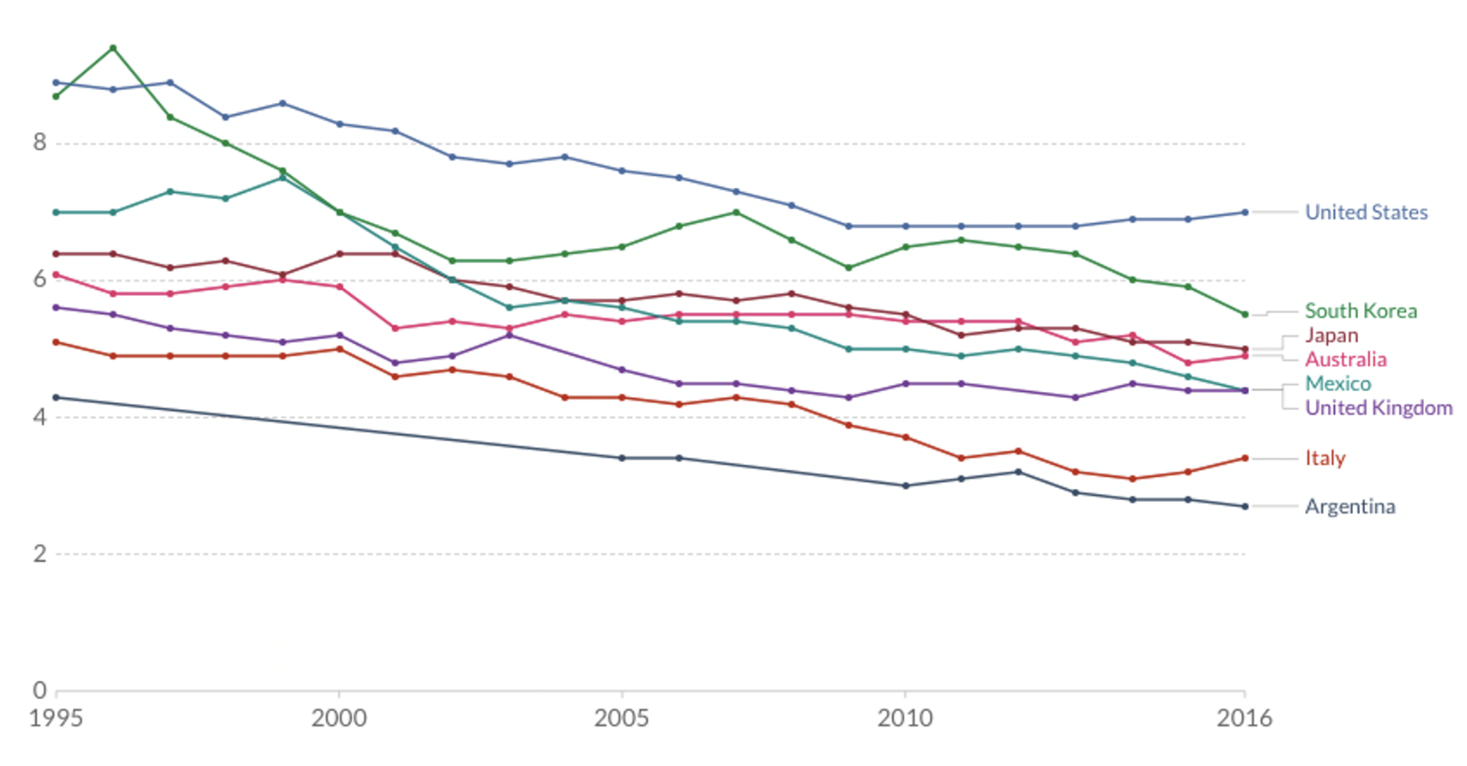
Culture, Love, and Marriage
Marriages per 1,000 People
Number of marriages in each year per 1,000 people in the population

Slide 31
What Hurts Relationships?
Conflict
Primary cause of marital dissolution
Communication problems are the chief reason given for getting divorced

Slide 32

What Hurts Relationships?
The Demand-Withdraw Pattern and Stonewalling
Four-step pattern particularly destructive to relationships
Stonewalling: A passive-aggressive attempt to punish the other person
Demand-withdrawal pattern of marital communication
Notes:
Four-step pattern particularly destructive to relationships:
Criticism and complaining
A sense of contempt
Defensiveness
Withdrawal

Slide 33
Gottman’s Multidimensional
Therapy Approach
Relationship
Undermining Behaviors
Replace With Relationship Enhancing Behaviors
Criticism
Contempt
Defensiveness
Stonewalling
Complaint
Appreciation
Responsibility
Self-soothing
Notes:
The relationship undermining behaviors are definitely listed in the chapter, however the relationship enhancing behaviors are not. Question of whether or not they should be left in, or whether this slide should be reformatted.

Slide 34
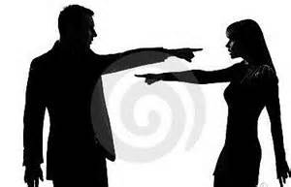
Gottman 4 Horsemen of Apocalypse
Criticism
  Complaint vs. criticism
  Complaining is normal and focuses on behavior
  Criticism attacks the character of the person
Complaint: "You should have told me earlier that you're too tired to make love. I'm disappointed, and I feel embarrassed."
Criticism: "Why are you so selfish? It was really nasty of you to lead me on. You should have told me earlier that you were too tired to make love."

Slide 35
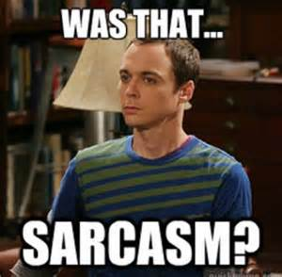
Gottman 4 Horsemen of Apocalypse
Contempt
  Often follows criticism
  Person uses "sarcasm, cynicism, name-calling, eye-rolling, sneering, mockery, and hostile humor
Worst of the 4 because it communicates disgust to the person it is directed toward, which escalates conflict

Slide 36
Gottman 4 Horsemen of Apocalypse
Defensiveness
  When one partner uses contempt, the other typically becomes defensive
Stonewalling
  One partner tunes out the other
  More common in men than women

Slide 37
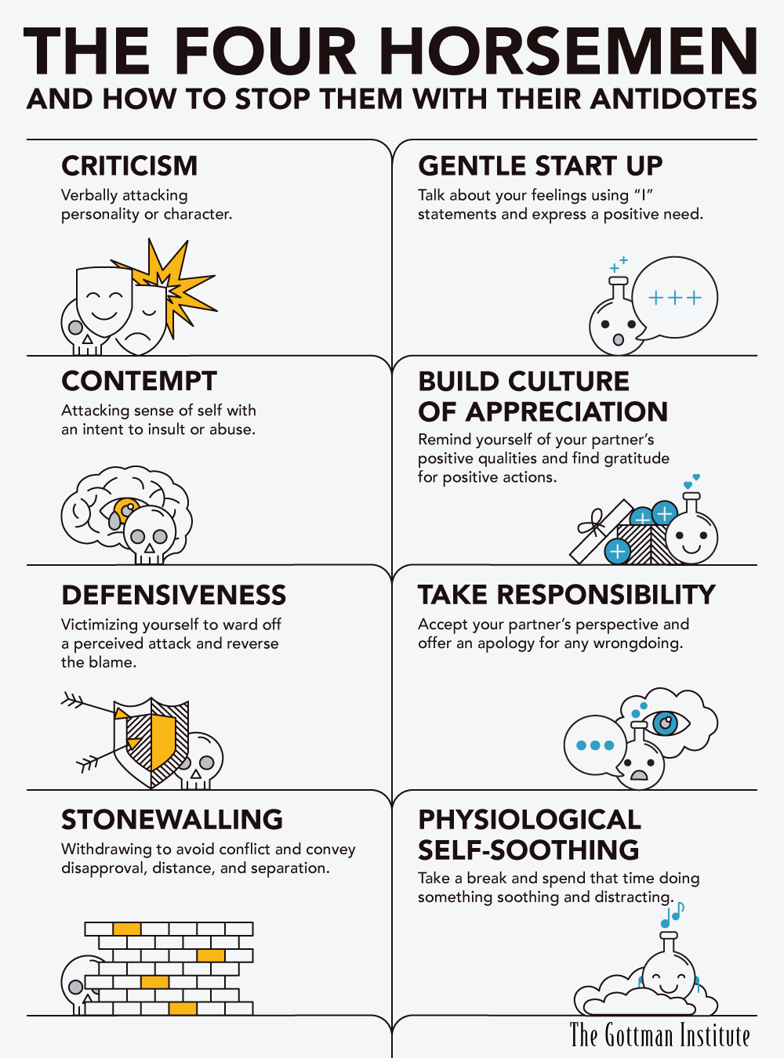

Slide 38
How to Nurture Positive Relationships That Last
The Seven Principles for Making Marriage Work (Gottman & Silver)
  Enhance your love maps
  Nurture your fondness and admiration
  Turn toward each other instead of away
  Let your partner influence you
  Solve your solvable problems
  Overcome gridlock and move toward dialogue
  Create shared meaning
Notes:
The Seven Principles for Making Marriage Work
Enhance your love maps
Nurture your fondness and admiration
Turn toward each other instead of away
Let your partner influence you
Solve your solvable problems
Overcome gridlock and move toward dialogue
Create shared meaning

Slide 39
How To Nurture All Relationships
Practice active listening
1
Show appreciation regularly
2
Be reliable and trustworthy
3
Invest time, even when busy
4
Resolve conflicts constructively (e.g., use “I” feel, or “I” noticed etc)
5
Celebrate good news together
6
Practice forgiveness
7
Be emotionally available
8

Slide 40
